Slide 1
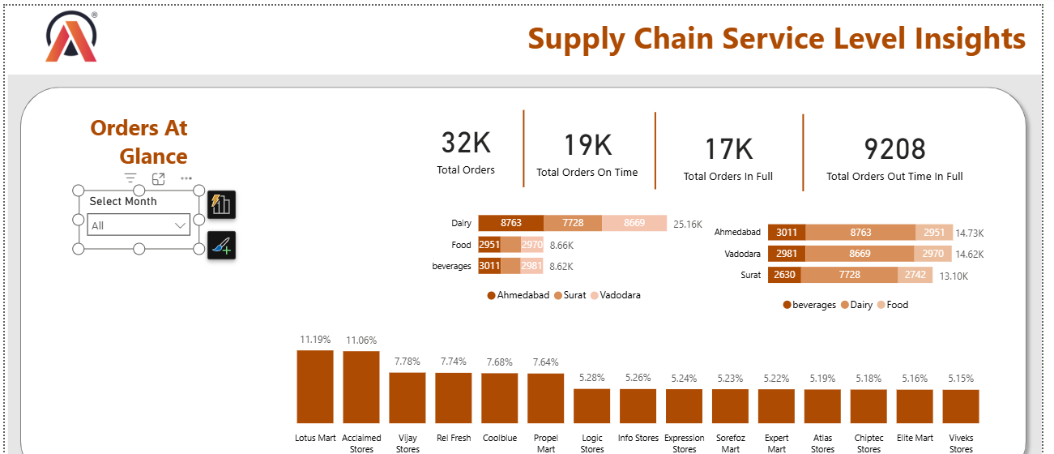
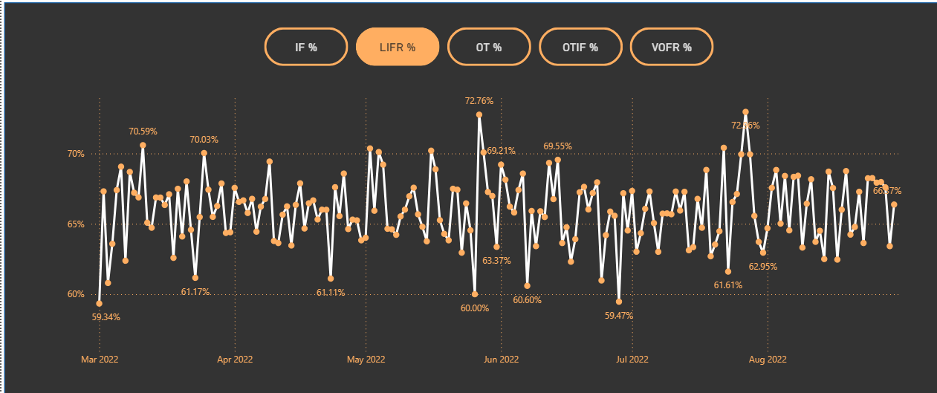
INSIGHTS
&
KEY FINDINGS
SUPPLY CHAIN SERVICE LEVEL INSIGHTS
Created by Achuth kumar .T

Slide 3
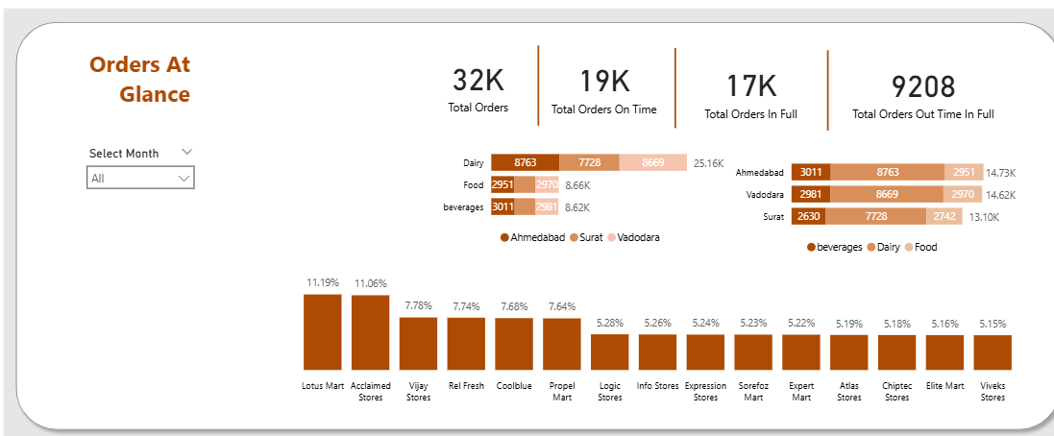
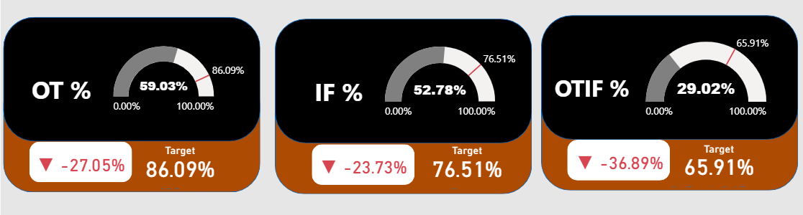
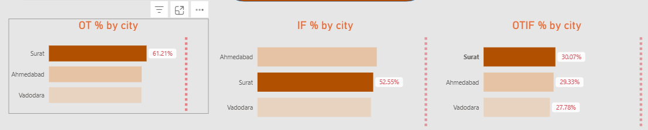
1
There is larger difference between total orders and total orders in full on time which might me the main reason for customer disatisfaction
2
Dairy Products have almost double the orders compared to other food categories
3
First 6 Customers Acclaimed Stores , Lotus Mart, Vijay Stores, Rel Fresh, Cool Blue & Propel Martis constituting 53% of Total orders & seems to be key customers
4
All kpi OT % ,IF %,OTIF % are way behind their targets,especially otif % which is very alarming indicates urgend need for end to end supply chain optimization
5
All cities are lagging behind their otif %,that means locality is not issue here,it’s a global service issue,with surat slightly leading and vadothara lowest

Slide 4
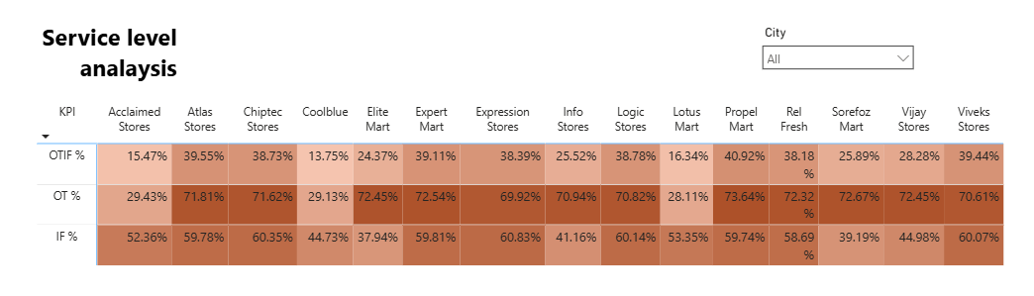
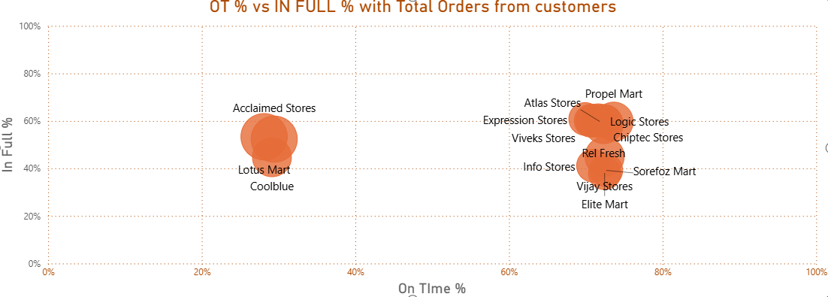
Service Level Analysis of Orders shows ForAcclaimed Stores , Cool Blue & Lotus Mart have some noticeably lower OT% and OTIF % even their IF% too are also not so much convincing.
this explains why contracts of this customers are not extending
Only Chiptec, Atlas, and Elite Mart have OTIF > 39%
1
2
Most of our remaining customes have some ot % and if %,which are far from stable otif %

Slide 5
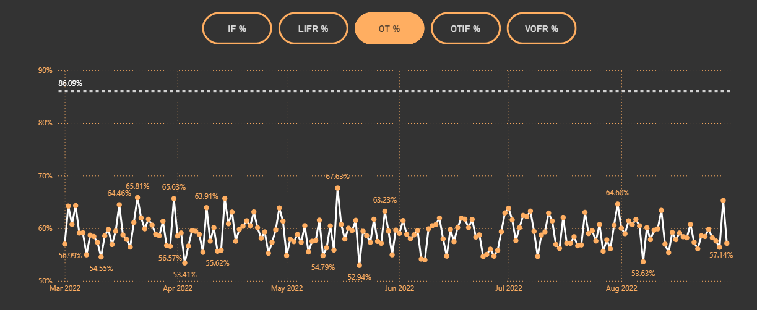
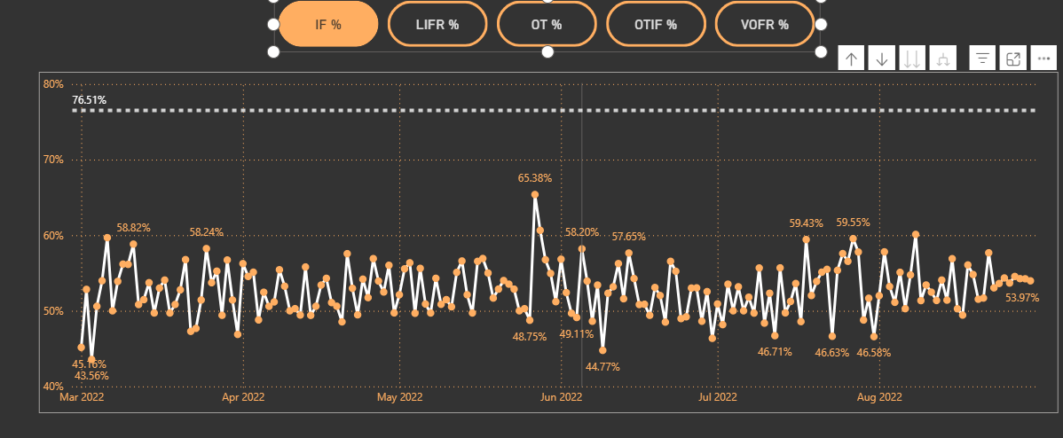
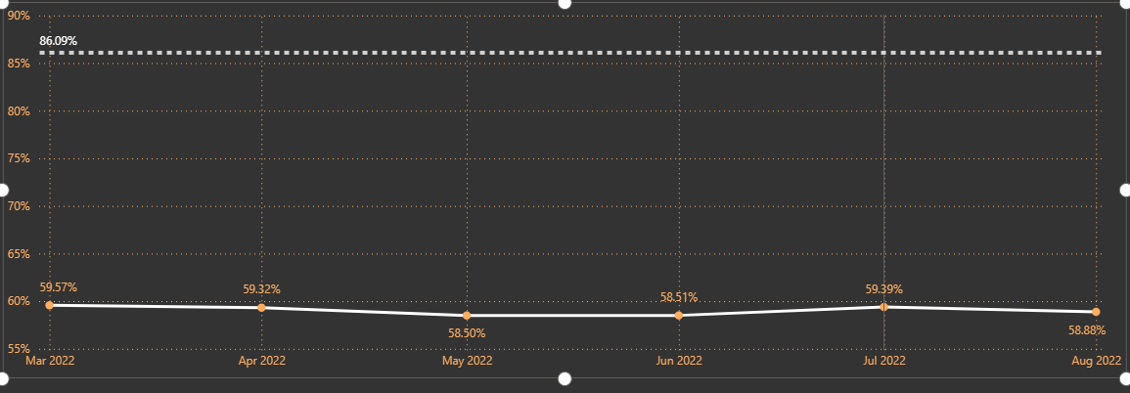
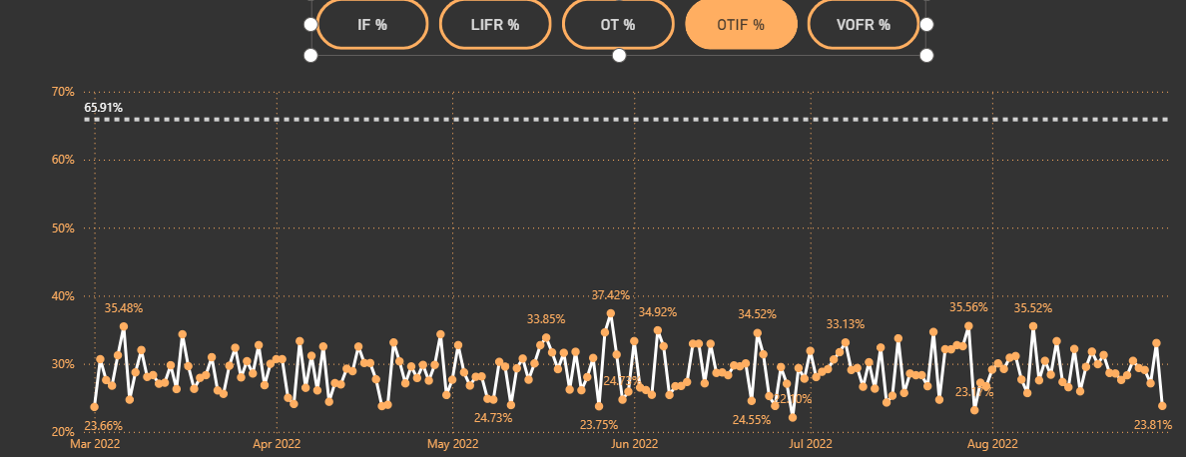
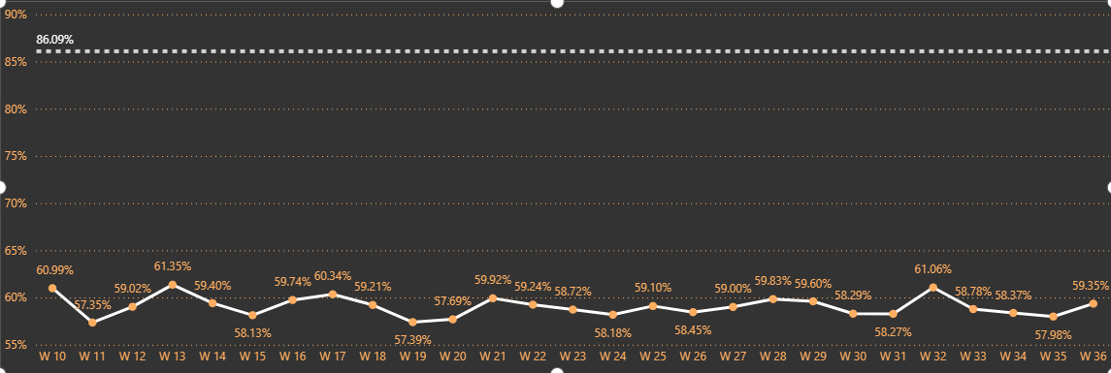
1
1
2
In Daily Trend for OT% Graphs for Order even
Daily level of OT% too are significantly lower than
Targeted OT%
OT % dropped significantly from jun to august
We showed drilling down from months to weeks to days to show more detailed view
2
OTIF % and IF % are also significantly lower than respective targets
Otif % is very low,which is more alarming to stockholders and company,which need to observed and solve the underlying issues
2

Slide 6
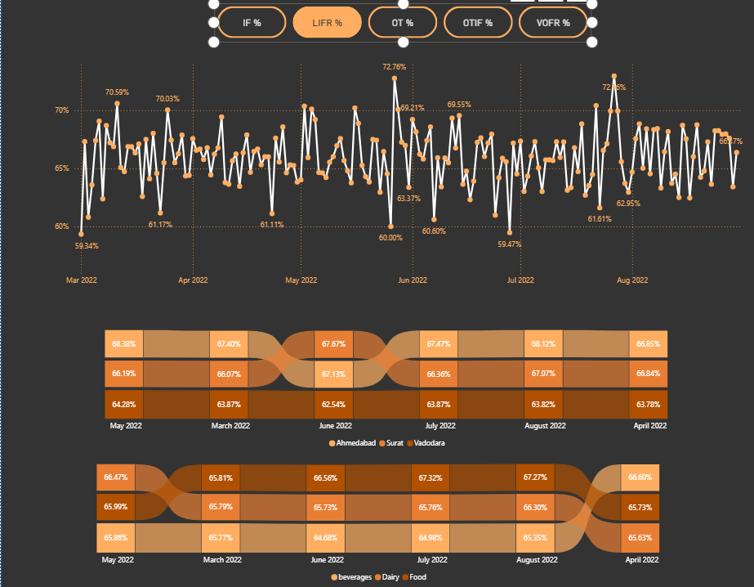
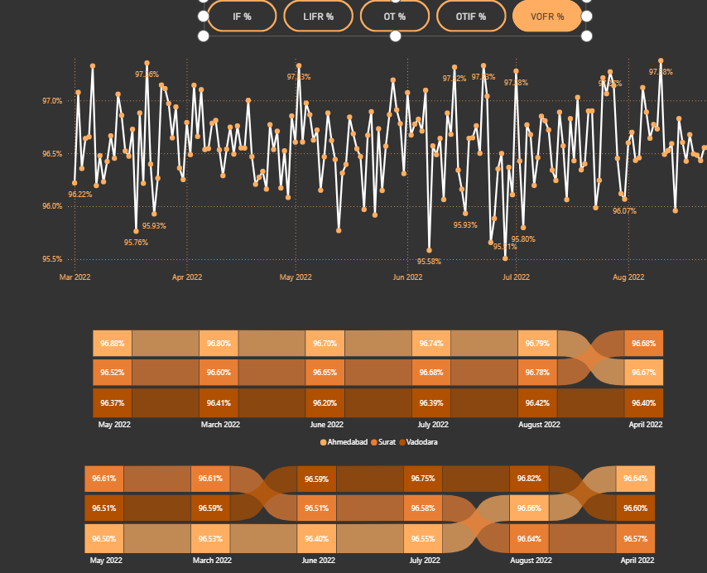
1
In Daily Trend of LIFR %,
We can see its easily fluctualtes from 60% to 72%
Peak lifr is observed during early June
Notable dips in March (~56.84%), mid-May (~60.68%), and late July (~61.91%)**
No Upwawrd trend is observed
In Reborn charts below
None of the cities sustain LIFR > 68% — all are well below optimal🍪
LIFR % is similar across all categories (Beverages, Dairy, Food) — around 65–67%Minor fluctuation
Lifr is low and not improving which might be cause for OTIF %, that effects customer experience,customers are not satisfied when their requested items are partially fullfilled
1
2
2
op Line Chart (VOFR Daily Trend)
VOFR is consistently high (~95.3% to 97.3%) with very few dips
🏙 Middle Ribbon (City-Wise VOFR %)
All cities (Ahmedabad, Surat, Vadodara) maintain VOFR > 96%
🍪 Bottom Ribbon (Product Category-Wise VOFR %)
All product categories show uniform VOFR performance
High VOFR shows that the overall volume is being delivered correctly
However, this masks the real issue: customers care about exact items (LIFR), not just quantityHigh VOFR but low LIFR explains why OTIF remains poor despite "good-looking" volume metrics

Slide 7
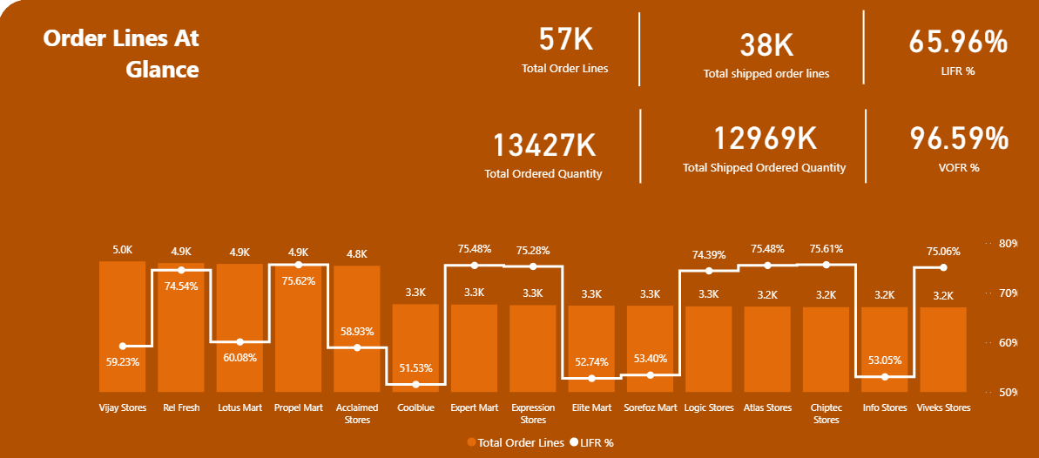
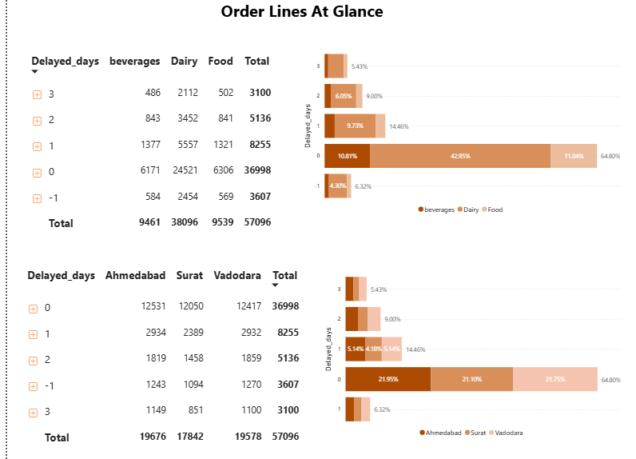
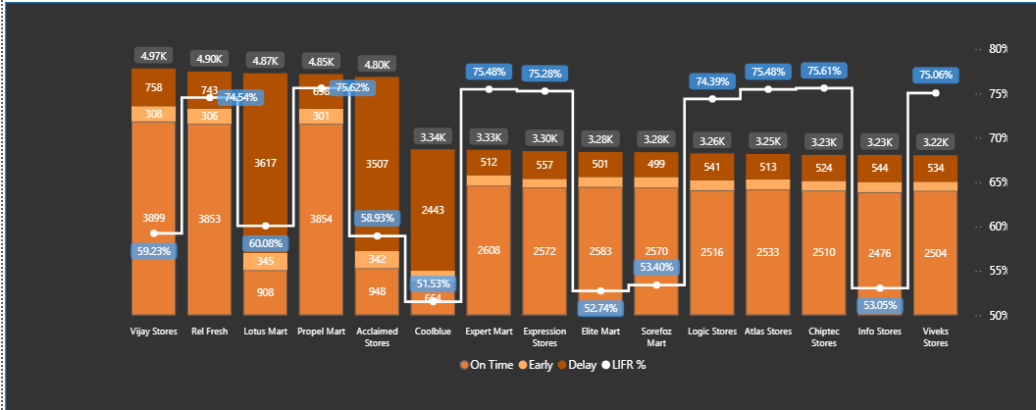
1
1
Initial analysis of Order Line overview shows:
Even though vofr % is stable hight enough.indicating that most of the volume is being delivered
But lifr % is very low due to partial fulfilment which underlines very serious problem with customers decline contributes to otif % loss
Acclaimed Stores , Cool Blue, Elite Mart, Info Stores, Lotus Mart, Sorefoz Mart & Vijay Stores
• Out of That Acclaimed Stores , Lotus Mart & Vijay Stores are the customers who have larger no. of order lines amongst al
2
Further detailed analysis of Line lead time analysis combined with delayed days analysis
reveals some interesting facts
75% orders are delivered on time or early and remaining orders are delay with 1-2 days
For Acclaimed Stores , Cool Blue & Lotus Mart more than 75% of times lines are
being delivered late
Moreover, out of that 75% delayed deliveries, 66% of them are late by 2 or 3 days
2
2

Slide 8
Final insights
Service level of atliq chain is very disappointing
Very low otif %,less orders are delivered on time and in full,leading to customers dissactisifaction
LIFR % is around 65% meaning many items are missing,which leades to decrease customers reliability and trust
Delayed orders are almost 1-2 days breaking promised deadlines
Acclaimed Stores , Cool Blue & Lotus Mart are the Key customers who would certainly not willing to renew the contract

